Slide 1
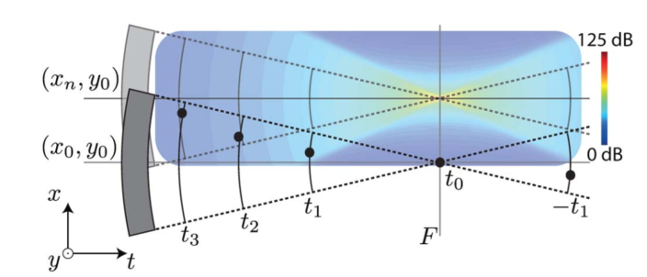
Sinogram Creation and Basic SAFT
Bar Weiss

Slide 2
Agenda
Sinogram Creation
SIR in the paper
Interpretation for our application
Use for creating a Sinogram
SAFT
Results

Slide 3
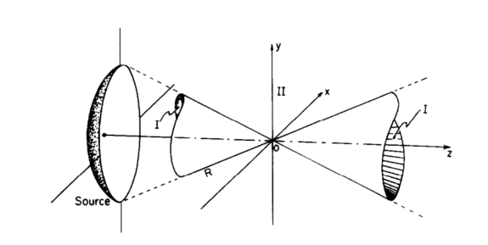

SIR in the Paper
Analysis done for a case where the transducer is transmitting an impulse
The time derivative of the SIR represents the pressure wave in any time and any location
Marcel Aditi et al, “Transient Fields of Concave Annular Array”, Academic Press 1981

Slide 4

Interpretation for Receiving Mode
In receiving mode, the SIR represent the receiver sensitivity
$∂_{t}h\left({\vec{r}}_{0},t\right)$ is the signal that will be received if the point ${\vec{r}}_{0}$generates an impulse
transducer
Point sources

Slide 5
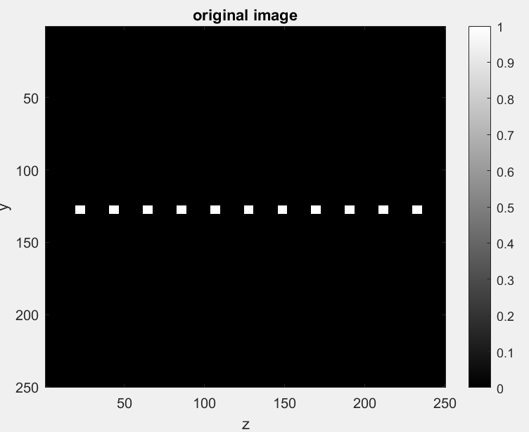
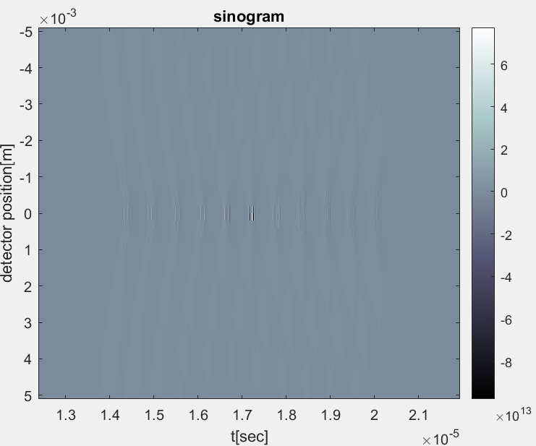

Sinogram Algorithm – Inputs and Outputs
Inputs
image representing the optical absorption $I\left(y,z\right)$
Transducer parameters
Number of detectors
Output: sinogram

Slide 6
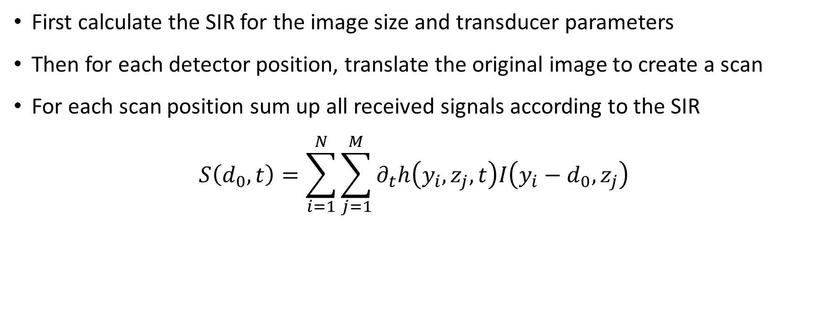
Sinogram Algorithm - Concept
First calculate the SIR for the image size and transducer parameters
Then for each detector position, translate the original image to create a scan
For each scan position sum up all received signals according to the SIR
$$S\left(d_{0},t\right)=\sum_{i=1}^{N}{\sum_{j=1}^{M}{∂_{t}h\left(y_{i},z_{j},t\right)I\left(y_{i}−d_{0},z_{j}\right)}}$$
transducer
y-scan

Slide 7
Sinogram Results – Simulation Conditions
Parameter | Unit | Value
Sensor diameter | mm | 13
Focal length | mm | 25
Speed of sound | m/s | 1480
Oversampling factor | - | 5
Image width | mm | 10
Spatial resolution | pixels | 250
Detector number | - | 250

Slide 8
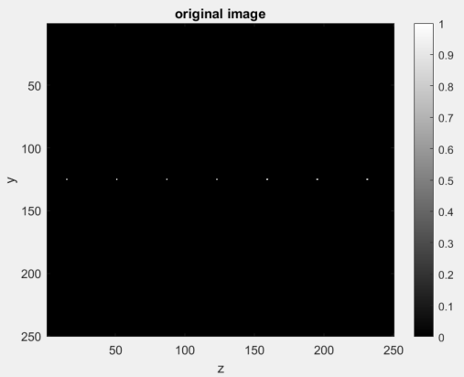
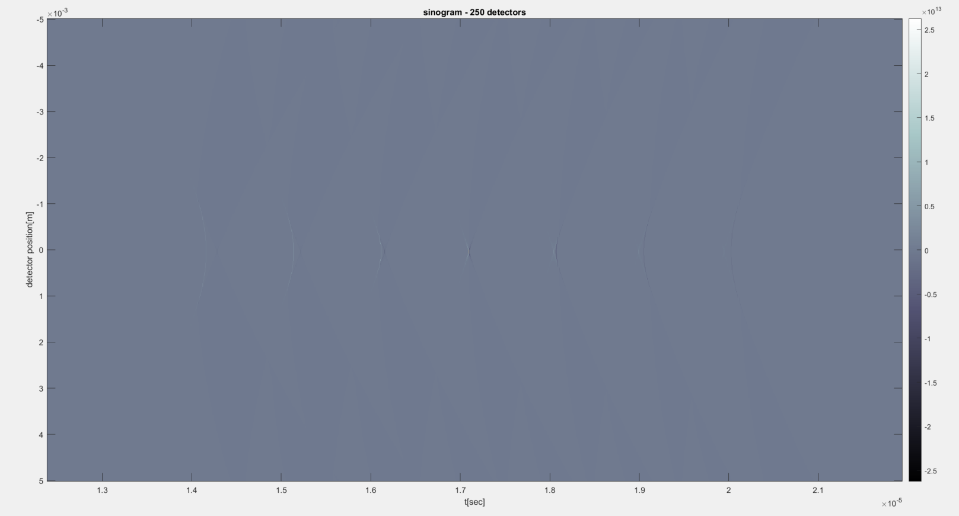
Sinogram Results

Slide 9
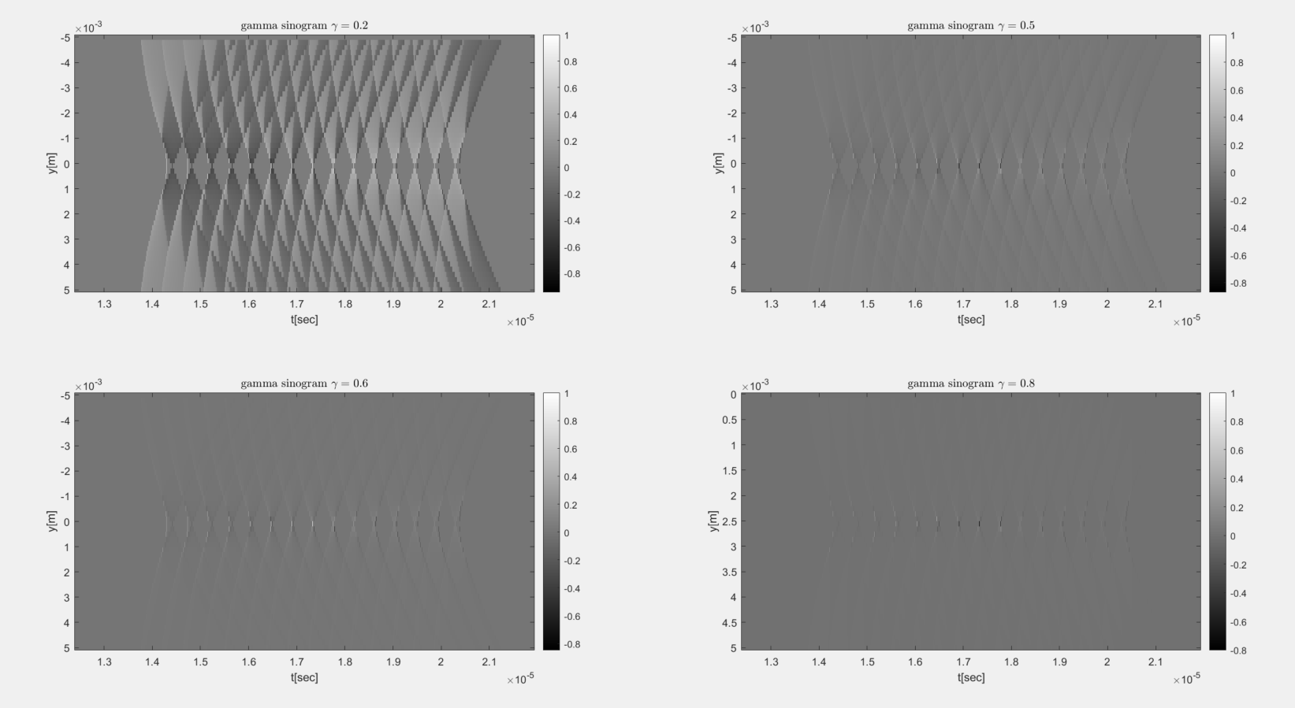
Sinogram Results – Gamma correction

Slide 10
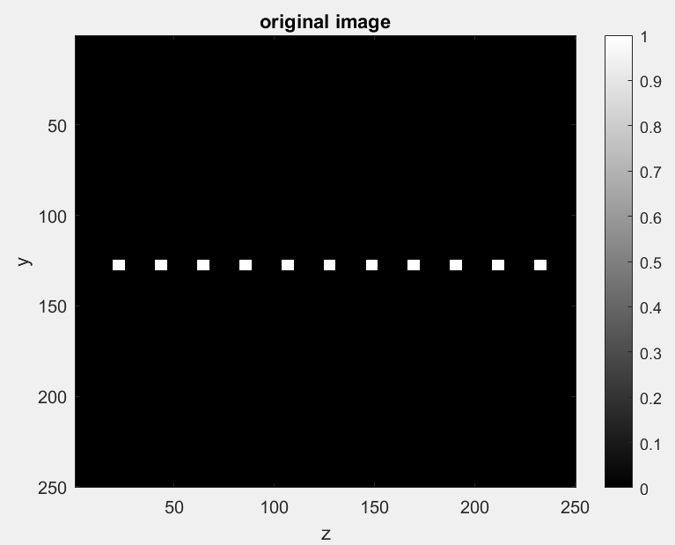
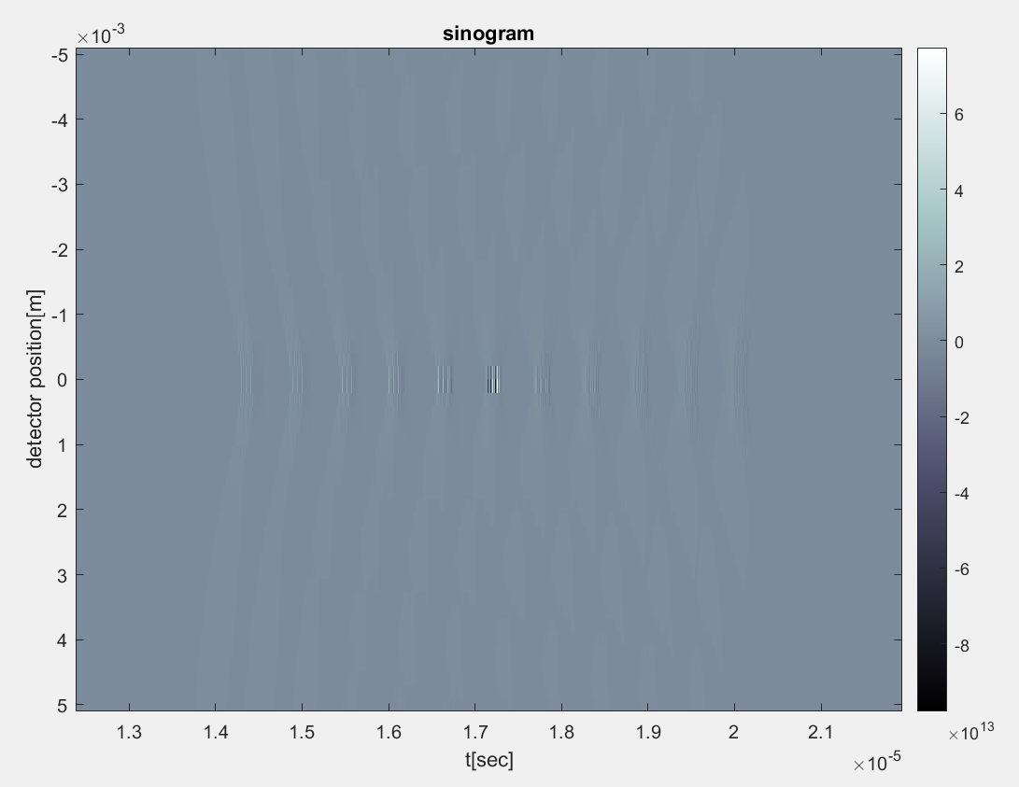
Sinogram Results

Slide 11

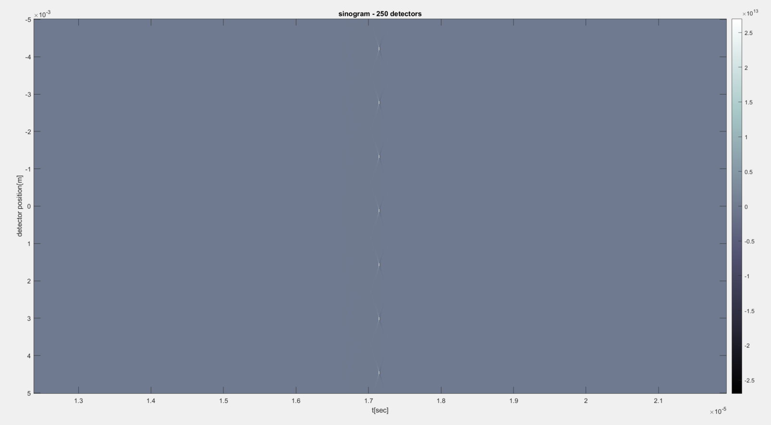
Sinogram Results

Slide 12
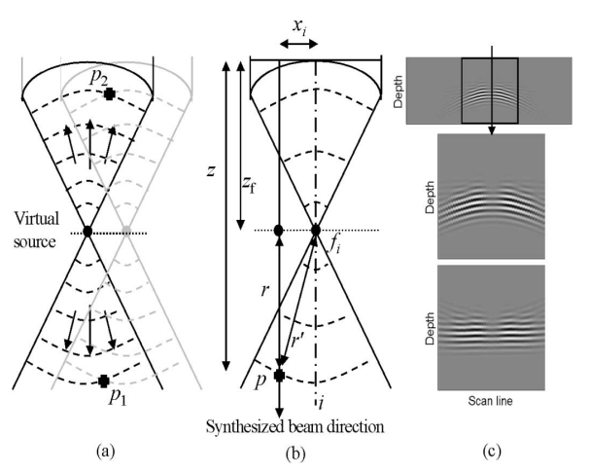

SAFT Algorithm
The algorithm treats the transducers focal point as a virtual source, that produces an approximately spherical wave-front over a limited angular extent
SAFT adds delays relative to the
virtual source.
Marcel Aditi et al, “Improved Synthetic Aperture Focusing Technique with Applications in High-Frequency Ultrasound Imaging ”, IEEE Transaction on Ultrasonics 2004

Slide 13
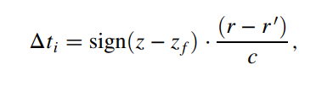
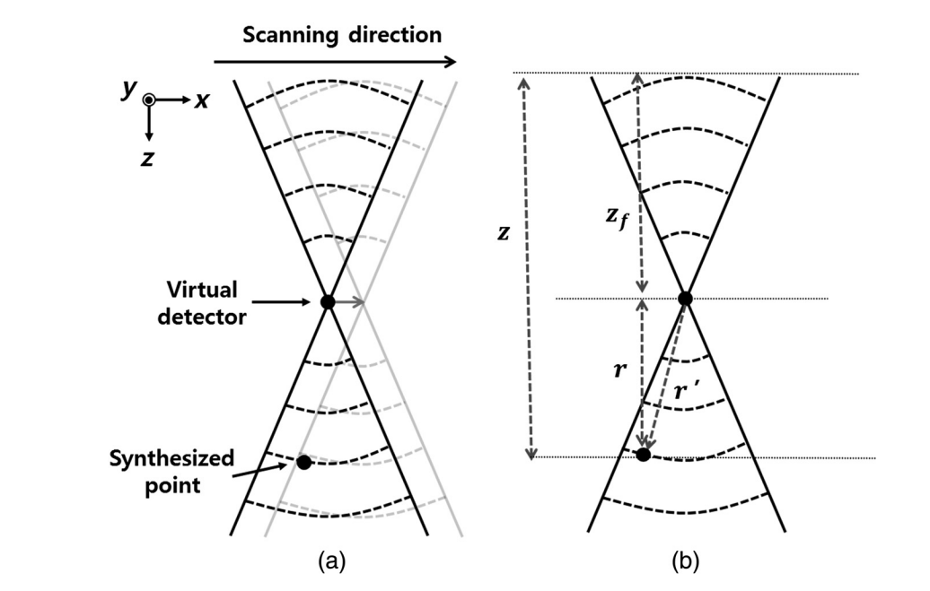
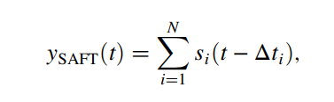
SAFT Algorithm - Formulation

Slide 14
SAFT Results – Simulation Conditions
Parameter | Unit | Value
Sensor diameter | mm | 13
Focal length | mm | 25
Speed of sound | m/s | 1480
Oversampling factor | - | 5
Image width | mm | 10
Spatial resolution | Pixels | 250
Detector number | - | 120/60
N – SAFT sum extent | - | 8/4

Slide 15
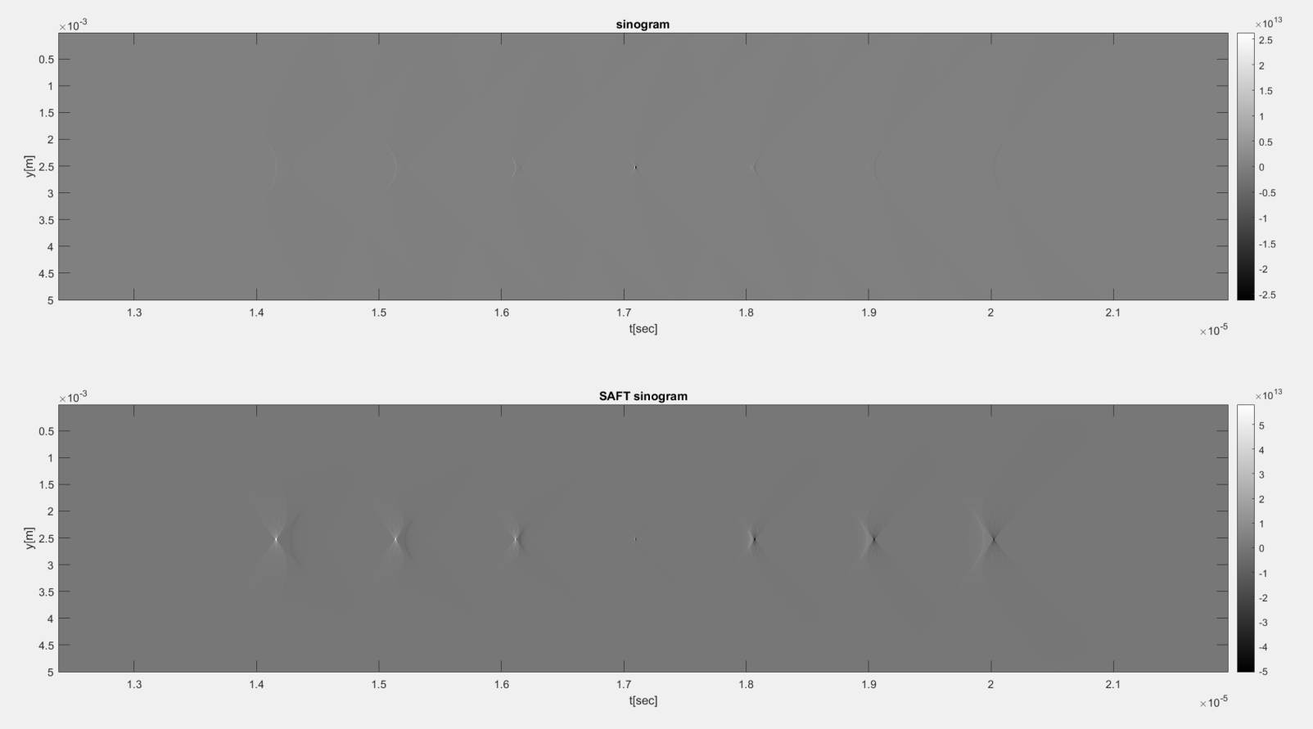
Basic SAFT Results – 250 detectors

Slide 16
SAFT with Windows
We can notice that the focal point disappears after the SAFT, but if we look at the gamma corrected image it is clearly there.
The problem is that the gain the SAFT adds to each point is asymmetric, close points receive more gain then the

Slide 17
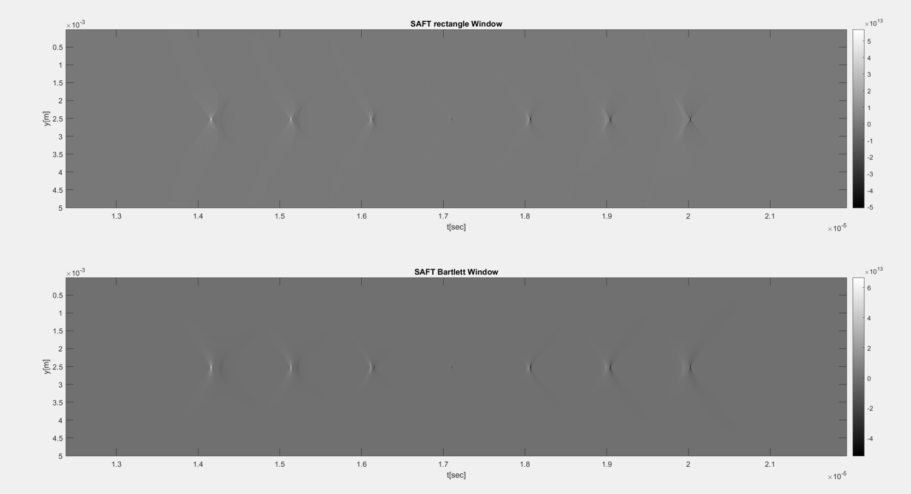
Rectangle and Bartlett

Slide 18
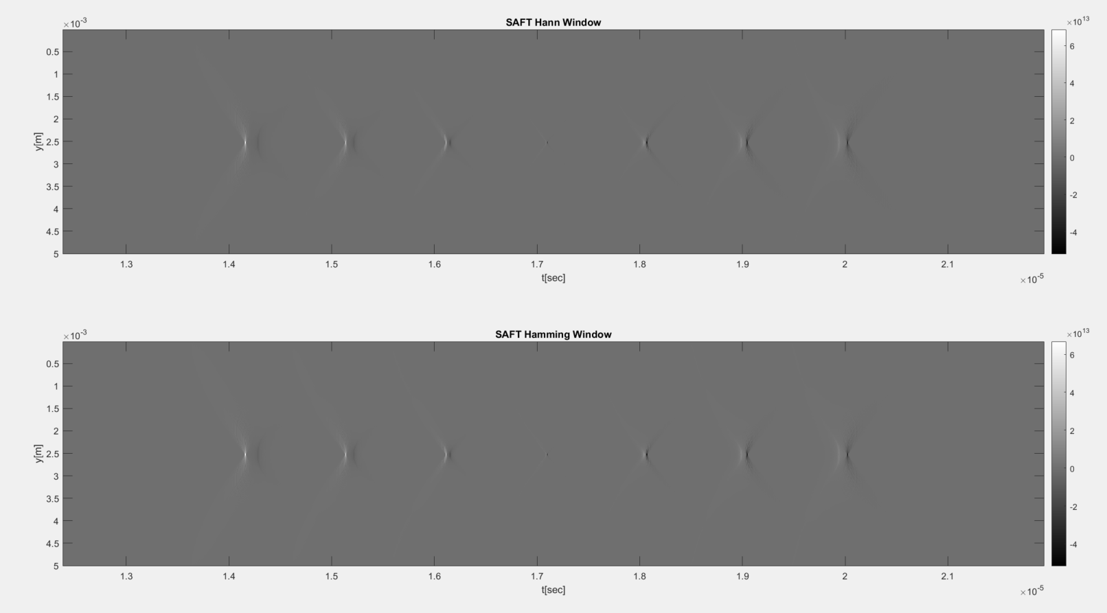
Hann and Hamming

Slide 19
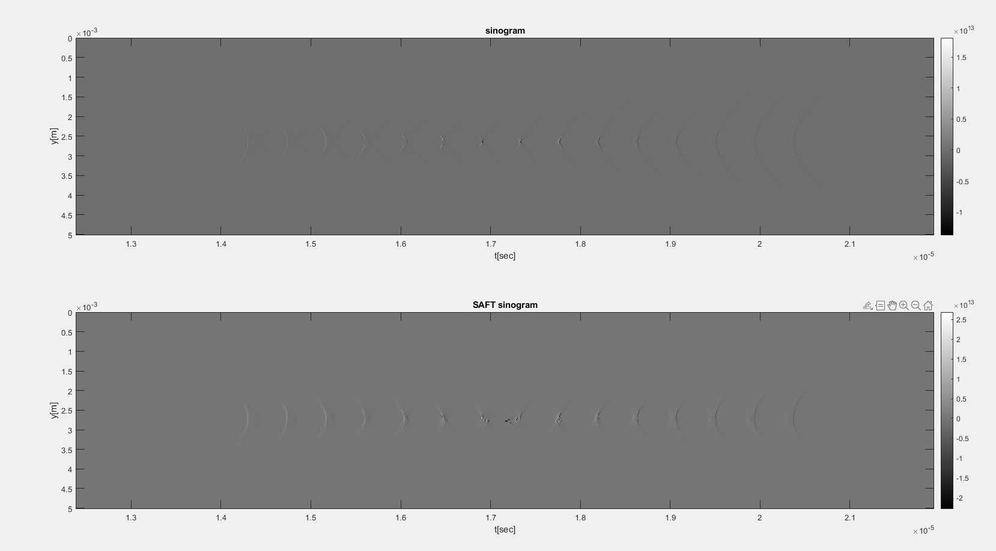
SAFT Results – 120 detectors

Slide 20
SAFT Results – 120 detectors

Slide 21
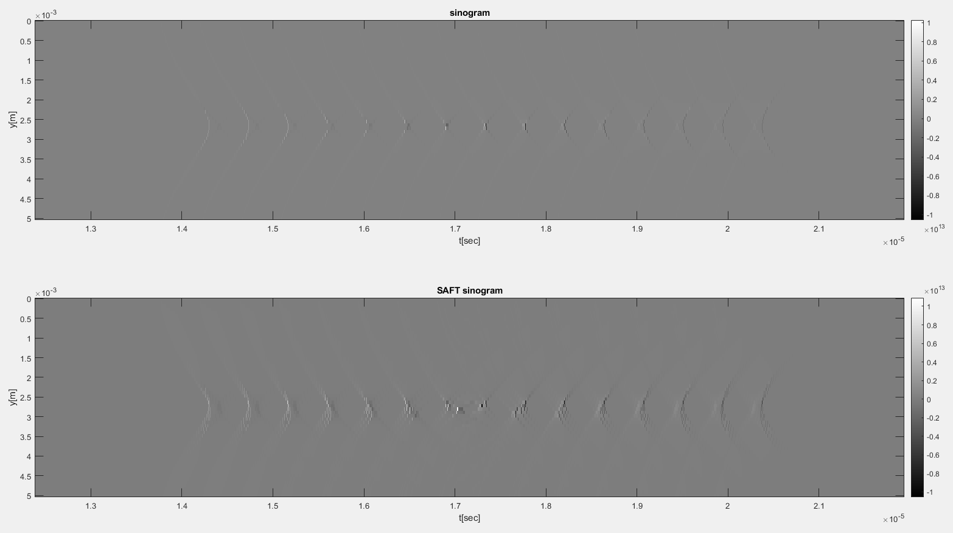
SAFT Results – 60 detectors

Slide 22
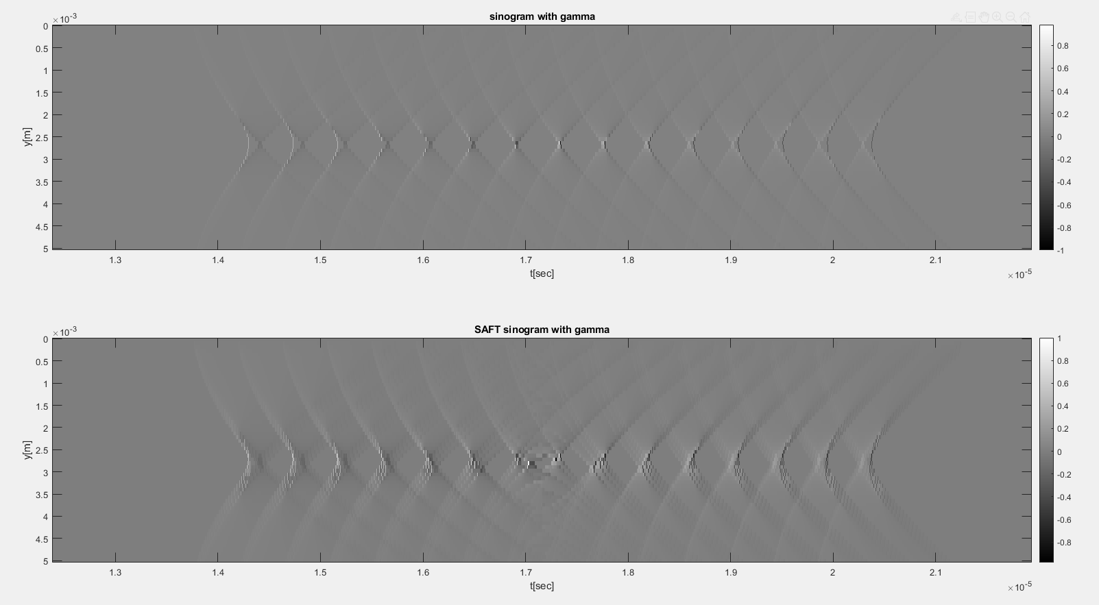
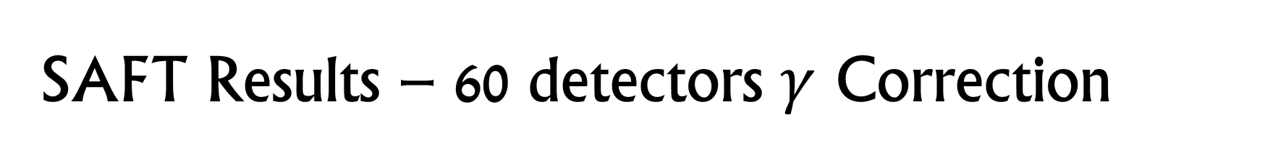
SAFT Results – 60 detectors $γ$ Correction

Slide 23

Further work
Create metrics for evaluation of sinograms
Explore limitations of basic SAFT and find methods to improve it

